Slide 1
Pokemon Stay!
The challenges of game creation using Python

Slide 2
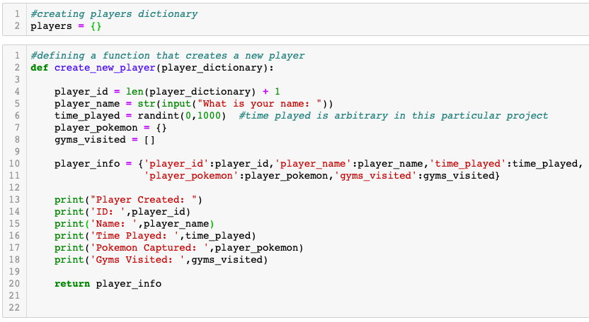
Creation of a Player
Key Points:
Player dictionary created at the beginning for ease of counting player ID
Player input of their own name
Creation of time played using a random integer
Player details printed for clarity

Slide 3
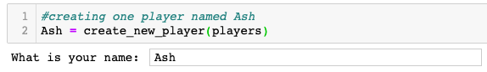

Creation of a Player continued

Slide 4
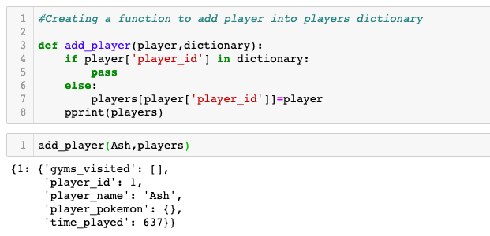
Adding Player to Dictionary
Key Points:
Simplicity of the function
Checks to see if the player is already in the dictionary
Stores player info in the dictionary with the player ID as the key
Ideally would be within the player creation function

Slide 5
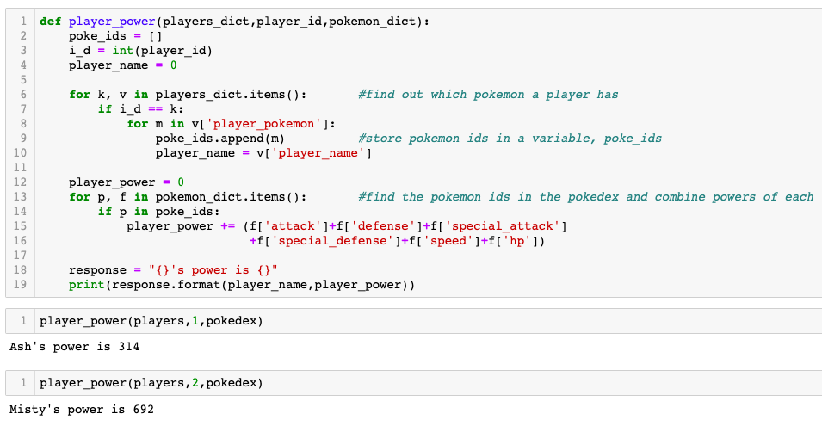
Calculating Player Power
Key Points:
Code separated into two sections to prevent confusion
First section uses the players dictionary to collect pokemon IDs and player name
Second section looks up the pokedex to calculate powers of each pokemon
Use of for k, v in .items()

Slide 6
Further Challenges
Issues to change to bring rules closer to actual Pokemon game:
Players can have multiple versions of the same pokemon, so each individual pokemon captured would need to be given some kind of key that is not it’s pokemon ID
Pokemon in the wild have varying base statistics so you would need to use a random variable calculator within the range of each type of pokemon
Pokemon have the ability to level up as they go to gyms, so the calculation of player power would need to be initialised at the time of capture of the pokemon and then continuously appended as gyms are visited

